Slide 1
Workshop
Hosted by CBaSe

Slide 2
Overview
Introduction
Why Programming
Why Python
Python in the industry
Learning Python
Set up Environment
Topics / Activities
Basic syntax
Loops / If statements
Arrays / Functions
Final project demo
Closing Remarks
Guest Speaker (if there is one)
Resources
Q/A

Slide 3
Introduction

Slide 4

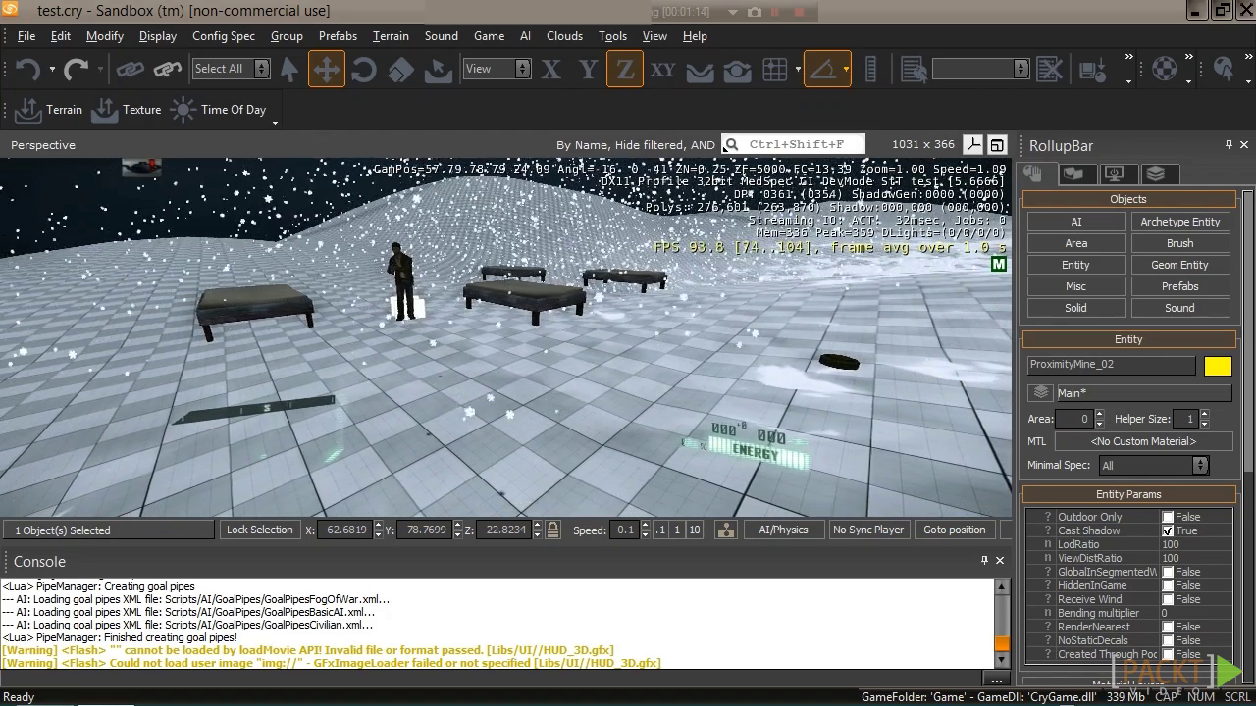


Why Programming
Notes:
Everything is becoming more computerized (look at mcdonald's replacing staff with automated kiosks), being computer savvy and able to code will always give an edge in the modern world.
Many business related jobs now are preferring some sort of programming or computer experience.
Helps develop problem solving skills and also allows you to have a more technical point of view when making decisions in a business.

Slide 5
Why Python?
-Most popular, high level, open source programming language
- Python 2 has been out since 1991, includes a vast number of libraries and tools
- Python is the future for AI and machine learning
- Python is used in education, software development, scientific, business applications
Notes:
Based on recent surveys, Python as and still is the MOST popular, high-level, open-source programming language.
Because it is a scripting language, it is fast and will run everywhere
Syntax is very basic, making it very easy to learn for beginners
Great basis for learning any other language
Python 2 has been out since 1991, vast number of libraries and tools available to work with Python
Great for analyzing lots of data and numbers and even visualizing it, excellent for analyst jobs
Ask business majors, how many of them have taken Econometrics. Ask them if they have used a program called R, if so then explain that R too is a coding language and very similar to python.

Slide 6
Python in the Industry
-AstraZeneca, one of the biggest pharmaceutical firms in the world, develops medicines to control pain, fight disease and battle cancer. To develop a new drug can cost upwards of 800 million! Python helps disparate the research groups around the role collaborate on drug identification and computer predictions
- Walt Disney -> Walt Disney Feature Animation is using Python to add script-ability to their animation production

Slide 7
Python VS R
Why use python over R?
R | Python
procedural language | Graphical Capabilities
Heavy learning curve | Ease of learning:
More code | extensive set of libraries

Slide 8
Where do we write the code?
Text editors
Atom : ttps://atom.io/
Sublime
IDE
Geany
Eclipse
Notes:
Text editors are exactly like they sound. They edit the text, or code. What makes them so special is that they are like Microsoft Word for code, they are tailored to try and auto correct/suggest code and also aim to make code more readable (using colors vs black text on a white screen).
IDE’s are a hyprid of a text editor and an environment. They allow for quick and incremental testing of code without swapping between terminal and editor.

Slide 9
Set up the Environment
Notes:
Check to see who has it and who doesn’t

Slide 10
Steps to download the required software
Mac:
Step 1:
Open terminal application
Step 2:
Install home brew using line: ruby -e "$(curl -fsSL https://raw.githubusercontent.com/Homebrew/install/master/install)"
Step 3:
Install Python with line: Brew install Python
Windows
Step 1:
Download Python 2.7.14 runtime for windows: https://www.Python.org/downloads/
Step 2:
Install Python. Press next at every step until it asks you to customize. Check off the Add to Path option and continue with installation.

Slide 11
Learning Python

Slide 12
Topic 1: Basic Syntax
#!/usr/bin/python
Variables - Value that can change, depending on conditions or information passed to the program
Print - a statement that gets
Raw input
Notes:
Talk about what #!/usr/bin/python is (location of python environment).
Explain what a variable is and different things it can separate
Explain how to print the value of variables or strings.
Discuss how to get input from users

Slide 13
Topic 2: Loops If statements
Importance of Tabs
If, Elif, and Else
AND & OR Logic
While Loops
For Loop
Notes:
So far we’ve been only writing single line - 4 lines of code, discuss tabs now that we need to use it for loops and statements.
Talk about how you can use if, elif and Else to make conditions for your code to handle
Show how we can incorporate simple logic gates to expand our conditions
Since we are talking about conditions, easy transition into what loops are and While loops
Once loop basis has been established we will look at For loops

Slide 14
Topic 3: Data Structures / Functions
Lists
Defining a Function
Calling a Function
Notes:
Discuss Arrays: Use a diagram to show (ask me for a pic) what an array would look like. I.e it is a list of objects (numbers, strings, etc) and why it is useful as a data structure
**Optional**
Talk about what a function is, starting with defining it, and then calling it in a program.

Slide 15
What you could do with Python
Notes:
Title in the works, basically transition to tkinter code. Letting viewers witness the potential of what their calculator could become.

Slide 16
How can Python help you?
FInancial modelling
Data visualization and analysis
Backtesting trades
Build a website with Django framework
Notes:
-As a business student, there is lot of data analysis involved
You can do a lot of things with spreadsheets like excel, but coding makes it easier to run various scenarios efficiently with few lines of code
-another advantages backtesting is done by reconstructing trades with historic data using a new strategy to see well your strategy performs. It is way easier to do with a programming language
-every business needs a website in today’s world, n it is super easy to build one. There are all sorts of tools available to build a website and python is super handy to build one, so why pay a software developer and waste your time explaining the design you have in your mind, when you can build one yourself!

Slide 17
Closing Remarks

Slide 18
Resources
Expanding your Portfolio
Github
Learning to Code
Tutorialspoint
Stackoverflow
Code Academy
Notes:
Talk about Github and how if they do decide to learn some coding, that this would be the best way to show employers. It is an online portfolio for sharing your projects and essentially a google drive that you can backup your code too.
The other links are all places you can go to learn and improve your coding ability. Code Academy provides you with lessons and tutorials with small projects like you’ve done today.
Tutorialspoint allows for you to look up libraries and syntax examples of every possible aspect of a language so you can learn how to use things like tkinter. Stackoverflow is a forum like website where you can post coding questions when you need help or find answers because someone probably has had the same question you had.

Slide 19
Thanks for participating!
Any Questions?

